Slide 1
General License Course
Chapter 5.1
Basic Modes and Bandwidth

Slide 2
Signal Review
Continuous wave (CW) – A radio signal at one frequency - a pure sine wave (unmodulated carrier - demo later)
Modulation – superimposing information (digital, analog) on a signal by changing its frequency, phase angle, or amplitude
Demodulation – recovering the information from a modulated signal

Slide 3
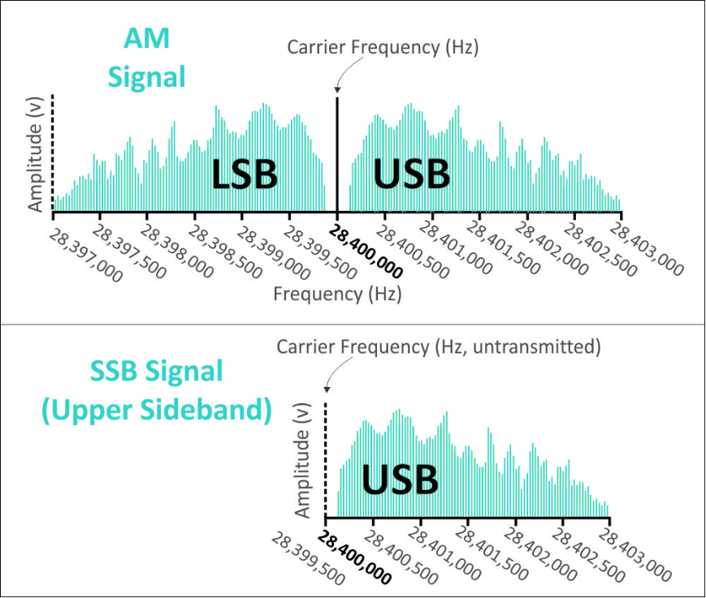
Amplitude Modulated Modes
An AM signal is composed of a carrier and two sidebands – one higher than the carrier frequency (upper sideband – USB) and one lower (lower sideband – LSB)
Each sideband contains a copy of the modulating information.
A single sideband (SSB) signal is an AM signal with the carrier and one sideband removed/suppressed.
Note spectrum occupied vs. carrier frequency

Slide 4
Moduation Modes
Amplitude Modulation (AM) is a mode that varies the instantaneous power level of the RF signal to add speech or data information
Frequency Modulation (FM) is a mode that varies the frequency of a signal to add speech or data information
Deviation is the amount that an FM signal’s frequency varies when modulated (5 kHz standard on VHF/UHF FM)
Phase modulation (PM) is created by varying a signal’s phase angle

Slide 5
Bandwidth
The FCC limits signal bandwidth so that many stations and types of signals can share the limited amount of spectrum
Single sideband is the phone emission which uses the narrowest bandwidth

Slide 6
Link Budgets
Link Budgets account for all the power gains and losses a signal experiences within a system
In amateur radio, this is generally the transmit power and antenna gains from the sending station minus any system losses the receiving station experiences
Losses result from ionospheric refraction, attenuation, or a variety of other causes
Link margin is the difference between the minimum power level needed to receive a signal (sensitivity) and the actual power level of the received signal, measured in dB

Slide 7
Take Quiz 1

Slide 8
G8A02 - What is the name of the process that changes the phase angle of an RF signal to convey information?
A. Phase convolution
B. Phase modulation
C. Phase transformation
D. Phase inversion

Slide 9
G8A02 - What is the name of the process that changes the phase angle of an RF signal to convey information?
A. Phase convolution
B. Phase modulation
C. Phase transformation
D. Phase inversion

Slide 10
G8A03 - What is the name of the process that changes the instantaneous frequency of an RF wave to convey information?
A. Frequency convolution
B. Frequency transformation
C. Frequency conversion
D. Frequency modulation

Slide 11
G8A03 - What is the name of the process that changes the instantaneous frequency of an RF wave to convey information?
A. Frequency convolution
B. Frequency transformation
C. Frequency conversion
D. Frequency modulation

Slide 12
G8A05 - What type of modulation varies the instantaneous power level of the RF signal?
A. Power modulation
B. Phase modulation
C. Frequency modulation
D. Amplitude modulation

Slide 13
G8A05 - What type of modulation varies the instantaneous power level of the RF signal?
A. Power modulation
B. Phase modulation
C. Frequency modulation
D. Amplitude modulation

Slide 14
G8A07 - Which of the following phone emissions uses the narrowest bandwidth?
A. Single sideband
B. Vestigial sideband
C. Phase modulation
D. Frequency modulation

Slide 15
G8A07 - Which of the following phone emissions uses the narrowest bandwidth?
A. Single sideband
B. Vestigial sideband
C. Phase modulation
D. Frequency modulation

Slide 16
G8A13 - What is a link budget?
A. The financial costs associated with operating a radio link
B. The sum of antenna gains minus system losses
C. The sum of transmit power and antenna gains minus system losses as seen at the receiver
D. The difference between transmit power and receiver sensitivity

Slide 17
G8A13 - What is a link budget?
A. The financial costs associated with operating a radio link
B. The sum of antenna gains minus system losses
C. The sum of transmit power and antenna gains minus system losses as seen at the receiver
D. The difference between transmit power and receiver sensitivity

Slide 18
G8A14 - What is link margin?
A. The opposite of fade margin
B. The difference between received power level and minimum required signal level at the input to the receiver
C. Transmit power minus receiver sensitivity
D. Receiver sensitivity plus 3 dB

Slide 19
G8A14 - What is link margin?
A. The opposite of fade margin
B. The difference between received power level and minimum required signal level at the input to the receiver
C. Transmit power minus receiver sensitivity
D. Receiver sensitivity plus 3 dB

Slide 20
General License Course
Chapter 5.2
Radios Building Blocks

Slide 21
In the following chapters we’ll learn about the fundamental circuits from which radios are built.
In modern radios, many of these functions can be performed on digitized signal data by software developed for digital signal processing (DSP)
A Software-Defined Radio (SDR) is one in which most signal processing functions (such as filtering, detection, modulation) are performed by software

Slide 22
Filters
Filters are used to attenuate or pass signals within a defined range of frequencies.
Classified by response, how they act on signals
Passband – the range of signals passed on
Stopband – the range of signals attenuated or rejected

Slide 23
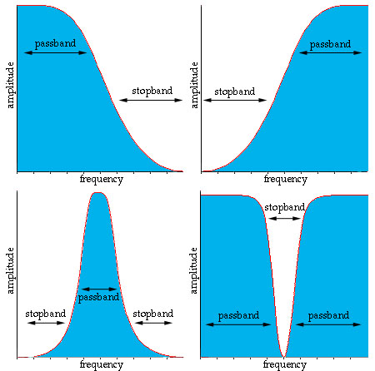
Filters
Low Pass – passes frequencies below the cutoff frequency
High Pass - passes frequencies above the cutoff frequency
Band Pass - passes frequencies between high and low cutoff frequencies (half-power points – next slide)
Band Stop (or Notch, if very narrow) – attenuates frequencies between high and low cutoff frequencies
Low Pass
High Pass
Notch
Band Pass

Slide 24
Filters
Cutoff frequency – the frequency at which the output signal power is reduced to one-half the input signal power (-3 dB)
Bandwidth – the frequency range between a filters upper and lower cutoff (half-power) frequencies (bandpass, notch)
Insertion Loss – signal loss or attenuation within the passband
Ultimate rejection – maximum attenuation outside of the passband
More on filters (including demos) later...

Slide 25
Oscillators
An oscillator consists of an amplifier that increases signal amplitude (gain) and a feedback circuit to route some of the amplifier’s output signal back to its input
Oscillator circuits must include a filter so that feedback is present at only the intended frequency
Oscillator = amplifier + filter + feedback loop
The oscillator output frequency can be fixed or variable

Slide 26
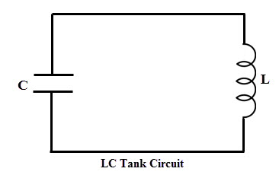
Oscillators
The filter of an LC oscillator is a resonant circuit made from inductors and capacitors. It sets the oscillator’s frequency
Parallel LC circuits are sometimes called tank circuits because they “store” energy
The output frequency of a variable-frequency oscillator (VFO) can be adjusted by changing the value of L or C

Slide 27
Oscillators
Two other widely used VFO circuits:
Phase-locked loop (PLL)
Direct digital synthesizer (DDS)
The Direct digital synthesizer has the advantage of being controllable by software and having stability comparable to a crystal oscillator – commonly used as the VFO in modern transceivers

Slide 28
Mixers
A mixer circuit combines signals (local oscillator, RF input) with two frequencies, f₁ and f₂, and produces signals with the sum and difference frequencies at its output. This mixing of two signals is also called heterodyning)
Example: If f₁ = 14.250 MHz and f₂ = 13.795 MHz, the output of the mixer will contain signals at both 455 KHz (f₁ – f₂) and at 28.045 MHz (f₁ + f₂: this will be filtered out)

Slide 29
C:\Users\ai2n\Videos\General Course - Videos\Visualizing Beat Frequencies.wmv

Slide 30
Multipliers
Multipliers create harmonics of an input signal to reach a desired operating frequency
Multipliers are often used when a stable VHF or UHF signal is required that cannot easily be generated directly at VHF/UHF (more later...)

Slide 31
Modulators
Modulator circuits add information to a carrier signal by varying its amplitude, frequency, or phase
The modulating information can be speech, data, or images

Slide 32
Amplitude Modulated Modes
An AM signal is composed of a carrier and two sidebands – one higher than the carrier frequency (upper sideband – USB) and one lower (lower sideband – LSB)
Each sideband contains a copy of the modulating information.
A single sideband (SSB) signal is an AM signal with the carrier and one sideband removed/suppressed.
Notice the bandwidth occupied vs. the carrier frequency!!

Slide 33
Frequency & Phase Modulation
Frequency modulation (FM) – the signal frequency varies (deviates) in proportion to the modulating signal’s amplitude
Phase modulation (PM) – deviation varies with both amplitude and frequency of the modulating signal
Phase modulation is produced by a reactance modulator connected to a tuned RF amplifier following the oscillator

Slide 34
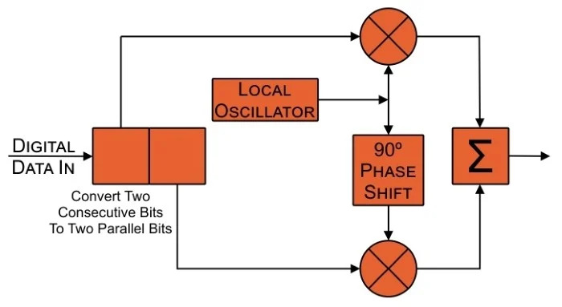
Quadrature or I/Q Modulation
Uses In-phase and Quadrature (shifted by 90°) signals – can produce signals with any form of modulation by varying the state (inverted or not) and modulation of the input signals
Well-suited to DSP
Widely used in SDRs

Slide 35
Take Quiz 2

Slide 36
G7B07 - Which of the following are basic components of a sine wave oscillator?
A. An amplifier and a divider
B. A frequency multiplier and a mixer
C. A circulator and a filter operating in a feed-forward loop
D. A filter and an amplifier operating in a feedback loop

Slide 37
G7B07 - Which of the following are basic components of a sine wave oscillator?
A. An amplifier and a divider
B. A frequency multiplier and a mixer
C. A circulator and a filter operating in a feed-forward loop
D. A filter and an amplifier operating in a feedback loop

Slide 38
G7B09 - What determines the frequency of an LC oscillator?
A. The number of stages in the counter
B. The number of stages in the divider
C. The inductance and capacitance in the tank circuit
D. The time delay of the lag circuit

Slide 39
G7B09 - What determines the frequency of an LC oscillator?
A. The number of stages in the counter
B. The number of stages in the divider
C. The inductance and capacitance in the tank circuit
D. The time delay of the lag circuit

Slide 40
G7C05 - Which of the following is characteristic of a direct digital synthesizer (DDS)?
A. Extremely narrow tuning range
B. Relatively high-power output
C. Pure sine wave output
D. Variable output frequency with the stability of a crystal oscillator

Slide 41
G7C05 - Which of the following is characteristic of a direct digital synthesizer (DDS)?
A. Extremely narrow tuning range
B. Relatively high-power output
C. Pure sine wave output
D. Variable output frequency with the stability of a crystal oscillator

Slide 42
G7C07 - What term specifies a filter's attenuation inside its passband?
A. Insertion loss
B. Return loss
C. Q
D. Ultimate rejection

Slide 43
G7C07 - What term specifies a filter's attenuation inside its passband?
A. Insertion loss
B. Return loss
C. Q
D. Ultimate rejection

Slide 44
G7C09 - What is the phase difference between the I and Q RF signals that software-defined radio (SDR) equipment uses for modulation and demodulation?
A. Zero
B. 90 degrees
C. 180 degrees
D. 45 degrees

Slide 45
G7C09 - What is the phase difference between the I and Q RF signals that software-defined radio (SDR) equipment uses for modulation and demodulation?
A. Zero
B. 90 degrees
C. 180 degrees
D. 45 degrees

Slide 46
G7C10 - What is an advantage of using I-Q modulation with software-defined radios (SDRs)?
A. The need for high resolution analog-to-digital converters is eliminated
B. All types of modulation can be created with appropriate processing
C. Minimum detectible signal level is reduced
D. Automatic conversion of the signal from digital to analog

Slide 47
G7C10 - What is an advantage of using I-Q modulation with software-defined radios (SDRs)?
A. The need for high resolution analog-to-digital converters is eliminated
B. All types of modulation can be created with appropriate processing
C. Minimum detectible signal level is reduced
D. Automatic conversion of the signal from digital to analog

Slide 48
G7C11 - Which of these functions is performed by software in a software-defined radio (SDR)?
A. Filtering
B. Detection
C. Modulation
D. All these choices are correct

Slide 49
G7C11 - Which of these functions is performed by software in a software-defined radio (SDR)?
A. Filtering
B. Detection
C. Modulation
D. All these choices are correct

Slide 50
G7C12 - What is the frequency above which a low-pass filter's output power is less than half the input power?
A. Notch frequency
B. Neper frequency
C. Cutoff frequency
D. Rolloff frequency

Slide 51
G7C12 - What is the frequency above which a low-pass filter's output power is less than half the input power?
A. Notch frequency
B. Neper frequency
C. Cutoff frequency
D. Rolloff frequency

Slide 52
G7C13 - What term specifies a filter's maximum ability to reject signals outside its passband?
A. Notch depth
B. Rolloff
C. Insertion loss
D. Ultimate rejection

Slide 53
G7C13 - What term specifies a filter's maximum ability to reject signals outside its passband?
A. Notch depth
B. Rolloff
C. Insertion loss
D. Ultimate rejection

Slide 54
G7C14 - The bandwidth of a band-pass filter is measured between what two frequencies?
A. Upper and lower half-power
B. Cutoff and rolloff
C. Pole and zero
D. Image and harmonic

Slide 55
G7C14 - The bandwidth of a band-pass filter is measured between what two frequencies?
A. Upper and lower half-power
B. Cutoff and rolloff
C. Pole and zero
D. Image and harmonic

Slide 56
G8A04 - What emission is produced by a reactance modulator connected to a transmitter RF amplifier stage?
A. Multiplex modulation
B. Phase modulation
C. Amplitude modulation
D. Pulse modulation

Slide 57
G8A04 - What emission is produced by a reactance modulator connected to a transmitter RF amplifier stage?
A. Multiplex modulation
B. Phase modulation
C. Amplitude modulation
D. Pulse modulation

Slide 58
G8B03 - What is another term for the mixing of two RF signals?
A. Heterodyning
B. Synthesizing
C. Frequency inversion
D. Phase inversion

Slide 59
G8B03 - What is another term for the mixing of two RF signals?
A. Heterodyning
B. Synthesizing
C. Frequency inversion
D. Phase inversion

Slide 60
G8B04 - What is the stage in a VHF FM transmitter that generates a harmonic of a lower frequency signal to reach the desired operating frequency?
A. Mixer
B. Reactance modulator
C. Balanced converter
D. Multiplier

Slide 61
G8B04 - What is the stage in a VHF FM transmitter that generates a harmonic of a lower frequency signal to reach the desired operating frequency?
A. Mixer
B. Reactance modulator
C. Balanced converter
D. Multiplier

Slide 62
G8B11 - What combination of a mixer's Local Oscillator (LO) and RF input frequencies is found in the output?
A. The ratio
B. The average
C. The sum and difference
D. The arithmetic product

Slide 63
G8B11 - What combination of a mixer's Local Oscillator (LO) and RF input frequencies is found in the output?
A. The ratio
B. The average
C. The sum and difference
D. The arithmetic product

Slide 64
General License Course
Chapter 5.3
Transmitters

Slide 65
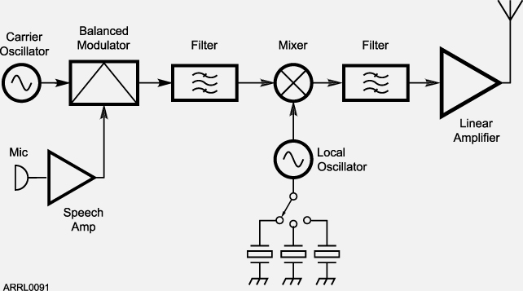
CW/SSB Phone Transmitter
In a CW transmitter (components in blue) the VFO feeds the mixer directly. The amplifier is keyed to generate CW. The local oscillator and crystals enable three band coverage.
In a SSB transmitter a balanced modulator stage combines signals from the carrier oscillator and speech amplifier to produce double sideband (DSB)
The first filter removes the unwanted sideband, producing SSB
The output of the first filter goes to the mixer
KEY
VFO

Slide 66
FM Transmitters
In a 2 meter FM transmitter, the modulated oscillator frequency is approximately 12 MHz
A Multiplier then provides the 12th harmonic for transmission (12 x 12 = 144 MHz)
For example, for an output on 146.52 MHz, the oscillator must produce a 146.52 ÷ 12 = 12.21 MHz signal

Slide 67
FM Transmitters
The Deviation of the 12 MHz modulated oscillator output is also multiplied
Example: If the 146.52 FM signal (produced from the 12 MHz oscillator) is to have the standard deviation of 5 kHz, the maximum deviation of the oscillator is:
5 kHz ÷ 12 = 416.7 Hz

Slide 68
FM Transmitters
Carson’s Rule is a formula that gives an approximation of an FM signal’s bandwidth (BW):
BW = 2 × (peak deviation + highest modulating frequency)
Example: If an FM phone signal’s peak deviation is limited to 5 kHz and the highest modulating frequency is 3 kHz, then:
BW = 2 × (5 + 3) = 16 kHz

Slide 69
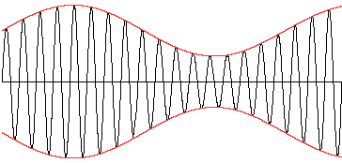
Amplitude Modulated Modes
Amplitude modulation (AM) is the instantaneous varying of the power or amplitude of a signal by adding speech or data information
The AM signal’s unmodulated carrier is a continuous wave whose amplitude does not change and contains no information
The AM signal’s modulation envelope follows the modulating signal. It is the waveform created by connecting the peak values of the modulated signal
Note: to prevent distortion Amplitude Modulation modes such as SSB require linear amplifiers whose outputs preserve the input signal waveform (more later...)

Slide 70
Signal Quality
Overmodulation – AM Modes:
Distorts the transmitted audio
Results in excessive bandwidth by creating unwanted spurious signals called splatter or buckshot
Often caused by misadjustment
Microphone gain set too high (reduce mic gain or speak more quietly)
Speech processor set too high (turn it down or off)

Slide 71
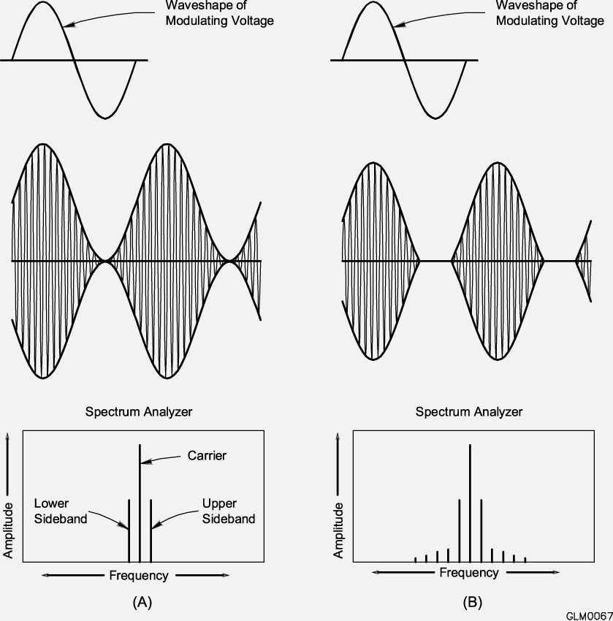
Modulation Envelope
The waveform created by connecting the peak values of the modulated signal
Overmodulation

Slide 72
Demo Video: AM Carrier, AM w/ Tone Modulation,
AM w/ Voice Modulation, SSB Modulation
C:\Users\ai2n\Videos\General Course - Videos\AM_and_SSB_Waveforms.wmv

Slide 73
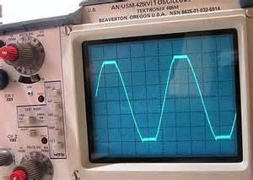
Overmodulation
If the drive or speech levels to transmitter output stages or external amplifiers is increased beyond the point of maximum output power level, the result is flat-topping or clipping
Use normal speech or audio levels during both testing and operation
Under difficult conditions it’s natural to raise your voice (only reduces intelligibility and causes excessive bandwidth)

Slide 74
Overmodulation
Automatic level control (ALC) system helps prevent overmodulation and excessive drive
ALC reduces output power on voice peaks
Mic gain (or transmit audio) should be adjusted to cause the ALC to activate only on voice peaks
A Two-tone test for transmitter linearity is very helpful in keeping your signal clean
Test consists of modulating your transmitter with a pair of audio tones that are not harmonically related (usually 700 and 1900 Hz)

Slide 75
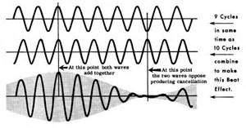
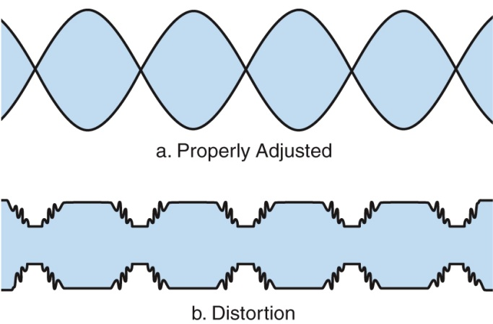
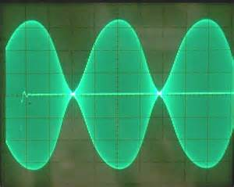
Two-Tone Test
LINEARITY
(vs Distortion)

Slide 76
Overdeviation
Overmodulated FM signals:
Overdeviation is caused by speaking too loudly or setting mic gain too high
The received signal is distorted
Creates interference to adjacent channels

Slide 77
Speech Processing
Speech processing increases the average power (apparent loudness) of the signal without excessively distorting the signal
The result is improved intelligibility of the received signal in poor conditions
Speech processors can also amplify low-level background noise, reducing intelligibility (balance average power improvement against reduction in intelligibility)

Slide 78
Speech Processing
Review: An incorrectly adjusted speech processor can cause:
Distorted speech
Excessive intermodulation products (Splatter)
Excessive background pickup
All of these choices are correct.

Slide 79
SSB Bandwidth
With the displayed carrier frequency set to 14.347 MHz, a 3 kHz USB signal occupies 14.347 to 14.350 MHz. When operating USB, your signal occupies a space starting at the displayed carrier frequency and extending up 3 kHz.
When the displayed carrier frequency is set to 7.178 MHz, a 3 kHz LSB signal occupies 7.175 to 7.178 MHz.
When operating in a General Class phone segment when using 3 kHz wide LSB, your displayed carrier frequency should be at least 3 kHz above the edge of the segment.
When operating in a General Class band, your displayed carrier frequency should be at least 3 kHz below the edge of the band when using 3 kHz wide USB.

Slide 80
Take Quiz 3

Slide 81
G2A12 - What control is typically adjusted for proper ALC setting on a single sideband transceiver?
A. RF clipping level
B. Transmit audio or microphone gain
C. Antenna inductance or capacitance
D. Attenuator level

Slide 82
G2A12 - What control is typically adjusted for proper ALC setting on a single sideband transceiver?
A. RF clipping level
B. Transmit audio or microphone gain
C. Antenna inductance or capacitance
D. Attenuator level

Slide 83
G4B07 - What signals are used to conduct a two-tone test?
A. Two audio signals of the same frequency shifted 90 degrees
B. Two non-harmonically related audio signals
C. Two swept frequency tones
D. Two audio frequency range square wave signals of equal amplitude

Slide 84
G4B07 - What signals are used to conduct a two-tone test?
A. Two audio signals of the same frequency shifted 90 degrees
B. Two non-harmonically related audio signals
C. Two swept frequency tones
D. Two audio frequency range square wave signals of equal amplitude

Slide 85
G4B08 - What transmitter performance parameter does a two-tone test analyze?
A. Linearity
B. Percentage of suppression of the carrier and undesired sideband for SSB
C. Percentage of frequency modulation
D. Percentage of carrier phase shift

Slide 86
G4B08 - What transmitter performance parameter does a two-tone test analyze?
A. Linearity
B. Percentage of suppression of the carrier and undesired sideband for SSB
C. Percentage of frequency modulation
D. Percentage of carrier phase shift

Slide 87
G4D01 - What is the purpose of a speech processor in a transceiver?
A. Increase the apparent loudness of transmitted voice signals
B. Increase transmitter bass response for more natural-sounding SSB signals
C. Prevent distortion of voice signals
D. Decrease high-frequency voice output to prevent out-of-band operation

Slide 88
G4D01 - What is the purpose of a speech processor in a transceiver?
A. Increase the apparent loudness of transmitted voice signals
B. Increase transmitter bass response for more natural-sounding SSB signals
C. Prevent distortion of voice signals
D. Decrease high-frequency voice output to prevent out-of-band operation

Slide 89
G4D02 - How does a speech processor affect a single sideband phone signal?
A. It increases peak power
B. It increases average power
C. It reduces harmonic distortion
D. It reduces intermodulation distortion

Slide 90
G4D02 - How does a speech processor affect a single sideband phone signal?
A. It increases peak power
B. It increases average power
C. It reduces harmonic distortion
D. It reduces intermodulation distortion

Slide 91
G4D03 - What is the effect of an incorrectly adjusted speech processor?
A. Distorted speech
B. Excess intermodulation products
C. Excessive background noise
D. All these choices are correct

Slide 92
G4D03 - What is the effect of an incorrectly adjusted speech processor?
A. Distorted speech
B. Excess intermodulation products
C. Excessive background noise
D. All these choices are correct

Slide 93
G4D08 - What frequency range is occupied by a 3 kHz LSB signal when the displayed carrier frequency is set to 7.178 MHz?
A. 7.178 MHz to 7.181 MHz
B. 7.178 MHz to 7.184 MHz
C. 7.175 MHz to 7.178 MHz
D. 7.1765 MHz to 7.1795 MHz

Slide 94
G4D08 - What frequency range is occupied by a 3 kHz LSB signal when the displayed carrier frequency is set to 7.178 MHz?
A. 7.178 MHz to 7.181 MHz
B. 7.178 MHz to 7.184 MHz
C. 7.175 MHz to 7.178 MHz
D. 7.1765 MHz to 7.1795 MHz

Slide 95
G4D09 - What frequency range is occupied by a 3 kHz USB signal with the displayed carrier frequency set to 14.347 MHz?
A. 14.347 MHz to 14.647 MHz
B. 14.347 MHz to 14.350 MHz
C. 14.344 MHz to 14.347 MHz
D. 14.3455 MHz to 14.3485 MHz

Slide 96
G4D09 - What frequency range is occupied by a 3 kHz USB signal with the displayed carrier frequency set to 14.347 MHz?
A. 14.347 MHz to 14.647 MHz
B. 14.347 MHz to 14.350 MHz
C. 14.344 MHz to 14.347 MHz
D. 14.3455 MHz to 14.3485 MHz

Slide 97
G4D10 - How close to the lower edge of a band's phone segment should your displayed carrier frequency be when using 3 kHz wide LSB?
A. At least 3 kHz above the edge of the segment
B. At least 3 kHz below the edge of the segment
C. At least 1 kHz below the edge of the segment
D. At least 1 kHz above the edge of the segment

Slide 98
G4D10 - How close to the lower edge of a band's phone segment should your displayed carrier frequency be when using 3 kHz wide LSB?
A. At least 3 kHz above the edge of the segment
B. At least 3 kHz below the edge of the segment
C. At least 1 kHz below the edge of the segment
D. At least 1 kHz above the edge of the segment

Slide 99
G4D11 - How close to the upper edge of a band's phone segment should your displayed carrier frequency be when using 3 kHz wide USB?
A. At least 3 kHz above the edge of the band
B. At least 3 kHz below the edge of the band
C. At least 1 kHz above the edge of the segment
D. At least 1 kHz below the edge of the segment

Slide 100
G4D11 - How close to the upper edge of a band's phone segment should your displayed carrier frequency be when using 3 kHz wide USB?
A. At least 3 kHz above the edge of the band
B. At least 3 kHz below the edge of the band
C. At least 1 kHz above the edge of the segment
D. At least 1 kHz below the edge of the segment

Slide 101
G7B10 - Which of the following describes a linear amplifier?
A. Any RF power amplifier used in conjunction with an amateur transceiver
B. An amplifier in which the output preserves the input waveform
C. A Class C high efficiency amplifier
D. An amplifier used as a frequency multiplier

Slide 102
G7B10 - Which of the following describes a linear amplifier?
A. Any RF power amplifier used in conjunction with an amateur transceiver
B. An amplifier in which the output preserves the input waveform
C. A Class C high efficiency amplifier
D. An amplifier used as a frequency multiplier

Slide 103
G7C01 - What circuit is used to select one of the sidebands from a balanced modulator?
A. Carrier oscillator
B. Filter
C. IF amplifier
D. RF amplifier

Slide 104
G7C01 - What circuit is used to select one of the sidebands from a balanced modulator?
A. Carrier oscillator
B. Filter
C. IF amplifier
D. RF amplifier

Slide 105
G7C02 - What output is produced by a balanced modulator?
A. Frequency modulated RF
B. Audio with equalized frequency response
C. Audio extracted from the modulation signal
D. Double-sideband modulated RF

Slide 106
G7C02 - What output is produced by a balanced modulator?
A. Frequency modulated RF
B. Audio with equalized frequency response
C. Audio extracted from the modulation signal
D. Double-sideband modulated RF

Slide 107
G8A08 - Which of the following is an effect of overmodulation?
A. Insufficient audio
B. Insufficient bandwidth
C. Frequency drift
D. Excessive bandwidth

Slide 108
G8A08 - Which of the following is an effect of overmodulation?
A. Insufficient audio
B. Insufficient bandwidth
C. Frequency drift
D. Excessive bandwidth

Slide 109
G8A10 - What is meant by the term "flat-topping," when referring to an amplitude-modulated phone signal?
A. Signal distortion caused by insufficient collector current
B. The transmitter's automatic level control (ALC) is properly adjusted
C. Signal distortion caused by excessive drive or speech levels
D. The transmitter's carrier is properly suppressed

Slide 110
G8A10 - What is meant by the term "flat-topping," when referring to an amplitude-modulated phone signal?
A. Signal distortion caused by insufficient collector current
B. The transmitter's automatic level control (ALC) is properly adjusted
C. Signal distortion caused by excessive drive or speech levels
D. The transmitter's carrier is properly suppressed

Slide 111
G8A11 - What is the modulation envelope of an AM signal?
A. The waveform created by connecting the peak values of the modulated signal
B. The carrier frequency that contains the signal
C. Spurious signals that envelop nearby frequencies
D. The bandwidth of the modulated signal

Slide 112
G8A11 - What is the modulation envelope of an AM signal?
A. The waveform created by connecting the peak values of the modulated signal
B. The carrier frequency that contains the signal
C. Spurious signals that envelop nearby frequencies
D. The bandwidth of the modulated signal

Slide 113
G8B06 - What is the total bandwidth of an FM phone transmission having 5 kHz deviation and 3 kHz modulating frequency?
A. 3 kHz
B. 5 kHz
C. 8 kHz
D. 16 kHz

Slide 114
G8B06 - What is the total bandwidth of an FM phone transmission having 5 kHz deviation and 3 kHz modulating frequency?
A. 3 kHz
B. 5 kHz
C. 8 kHz
D. 16 kHz

Slide 115
G8B07 - What is the frequency deviation for a 12.21 MHz reactance modulated oscillator in a 5 kHz deviation, 146.52 MHz FM phone transmitter?
A. 101.75 Hz
B. 416.7 Hz
C. 5 kHz
D. 60 kHz

Slide 116
G8B07 - What is the frequency deviation for a 12.21 MHz reactance modulated oscillator in a 5 kHz deviation, 146.52 MHz FM phone transmitter?
A. 101.75 Hz
B. 416.7 Hz
C. 5 kHz
D. 60 kHz

Slide 117
Chapter 5.3 (con’t) - Amplifiers
High-power HF amplifiers often use vacuum tube circuits that require operator adjustment (more to come)
Solid-state RF power amps are becoming more common - USE CAUTION: excessive drive power can damage them: use automatic level control (ALC) to prevent this
Review: Amplitude Modulation modes such as SSB require linear amplifiers whose outputs preserve the input signal waveform

Slide 118
Amplifier Classes
Class A – The most linear - it amplifies the entire waveform (never turns off)
Lowest signal distortion, Least efficient
Class AB - amplifying devices on >50% but <100% of the waveform
Class B – a pair of amplifying devices each on 50% of the time - cross-over distortion is a possibility
Class C – amplifying devices are active for less than one-half of the signal’s cycle
Class C has the highest efficiency but poor linearity
Class C is only suitable for CW and FM because those modes don't require good linearity

Slide 119
Amateur Amplifiers
Most linear amplifiers can be operated in either Class AB for SSB operation or in Class C for CW
The efficiency of an amplifier is defined as the RF output power divided by the DC input power (both in watts)

Slide 120
Manual Amplifier Tuning
Set the band switch to proper frequency
Apply a small amount of drive power while adjusting the TUNE (Plate) control to minimum (“dip”) plate current
Adjust the LOAD (Coupling) control to maximize (or “peak”) output power WITHOUT exceeding maximum rated plate current
DIP the Plate (Tune), PEAK the Load (Coupling)

Slide 121
Amplifier Tuning
C:\Users\ai2n\Videos\General Course - Videos\Heathkit_SB-220_Linear_Amplifier Tuning.wmv

Slide 122
Amplifier Tuning
Continue to adjust drive, tune, load for desired output power
Watch meters to prevent exceeding the maximum grid and plate current
Input power may also be adjusted during the process
Continue adjustments until desired output power is reached

Slide 123
Neutralization
HF amplifiers are susceptible to oscillation (called self-oscillation) due to positive feedback from stray capacitance
Self-oscillation creates spurious output signals and may damage the tube or amplifier components
The technique of preventing self-oscillation by providing carefully-phased negative feedback is called neutralization

Slide 124
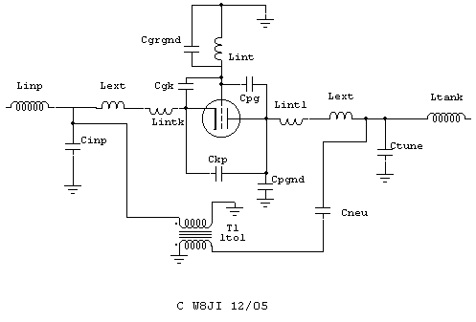
Neutralization

Slide 125
Amplifiers
Transceivers often include a delay in the keying circuit that is used to key the amplifier (and other devices)
The delay assures that the Transmit/Receive (T/R) relay is completely switched before the transceiver is allowed to supply any RF output
The delay prevents hot-switching, which can damage the T/R relay or other external devices

Slide 126
Take Quiz 4

Slide 127
G4A04 - What is the effect on plate current of the correct setting of a vacuum-tube RF power amplifier's TUNE control?
A. A pronounced peak
B. A pronounced dip
C. No change will be observed
D. A slow, rhythmic oscillation

Slide 128
G4A04 - What is the effect on plate current of the correct setting of a vacuum-tube RF power amplifier's TUNE control?
A. A pronounced peak
B. A pronounced dip
C. No change will be observed
D. A slow, rhythmic oscillation

Slide 129
G4A05 - Why is automatic level control (ALC) used with an RF power amplifier?
A. To balance the transmitter audio frequency response
B. To reduce harmonic radiation
C. To prevent excessive drive
D. To increase overall efficiency

Slide 130
G4A05 - Why is automatic level control (ALC) used with an RF power amplifier?
A. To balance the transmitter audio frequency response
B. To reduce harmonic radiation
C. To prevent excessive drive
D. To increase overall efficiency

Slide 131
G4A08 - What is the correct adjustment for the LOAD or COUPLING control of a vacuum tube RF power amplifier?
A. Minimum SWR on the antenna
B. Minimum plate current without exceeding maximum allowable grid current
C. Highest plate voltage while minimizing grid current
D. Desired power output without exceeding maximum allowable plate current

Slide 132
G4A08 - What is the correct adjustment for the LOAD or COUPLING control of a vacuum tube RF power amplifier?
A. Minimum SWR on the antenna
B. Minimum plate current without exceeding maximum allowable grid current
C. Highest plate voltage while minimizing grid current
D. Desired power output without exceeding maximum allowable plate current
TERRIBLE wording! PEAK the load/coupling control without exceeding...

Slide 133
G4A09 - What is the purpose of delaying RF output after activating a transmitter's keying line to an external amplifier?
A. To prevent key clicks on CW
B. To prevent transient overmodulation
C. To allow time for the amplifier to switch the antenna between the transceiver and the amplifier output
D. To allow time for the amplifier power supply to reach operating level

Slide 134
G4A09 - What is the purpose of delaying RF output after activating a transmitter's keying line to an external amplifier?
A. To prevent key clicks on CW
B. To prevent transient overmodulation
C. To allow time for the amplifier to switch the antenna between the transceiver and the amplifier output
D. To allow time for the amplifier power supply to reach operating level

Slide 135
G7B01 - What is the purpose of neutralizing an amplifier?
A. To limit the modulation index
B. To eliminate self-oscillations
C. To cut off the final amplifier during standby periods
D. To keep the carrier on frequency

Slide 136
G7B01 - What is the purpose of neutralizing an amplifier?
A. To limit the modulation index
B. To eliminate self-oscillations
C. To cut off the final amplifier during standby periods
D. To keep the carrier on frequency

Slide 137
G7B02 - Which of these classes of amplifiers has the highest efficiency?
A. Class A
B. Class B
C. Class AB
D. Class C

Slide 138
G7B02 - Which of these classes of amplifiers has the highest efficiency?
A. Class A
B. Class B
C. Class AB
D. Class C

Slide 139
G7B04 - In a Class A amplifier, what percentage of the time does the amplifying device conduct?
A. 100%
B. More than 50% but less than 100%
C. 50%
D. Less than 50%

Slide 140
G7B04 - In a Class A amplifier, what percentage of the time does the amplifying device conduct?
A. 100%
B. More than 50% but less than 100%
C. 50%
D. Less than 50%

Slide 141
G7B08 - How is the efficiency of an RF power amplifier determined?
A. Divide the DC input power by the DC output power
B. Divide the RF output power by the DC input power
C. Multiply the RF input power by the reciprocal of the RF output power
D. Add the RF input power to the DC output power

Slide 142
G7B08 - How is the efficiency of an RF power amplifier determined?
A. Divide the DC input power by the DC output power
B. Divide the RF output power by the DC input power
C. Multiply the RF input power by the reciprocal of the RF output power
D. Add the RF input power to the DC output power

Slide 143
G7B11 - For which of the following modes is a Class C power stage appropriate for amplifying a modulated signal?
A. SSB
B. FM
C. AM
D. All these choices are correct

Slide 144
G7B11 - For which of the following modes is a Class C power stage appropriate for amplifying a modulated signal?
A. SSB
B. FM
C. AM
D. All these choices are correct

Slide 145
General License Course
Chapter 5.4
Receivers

Slide 146
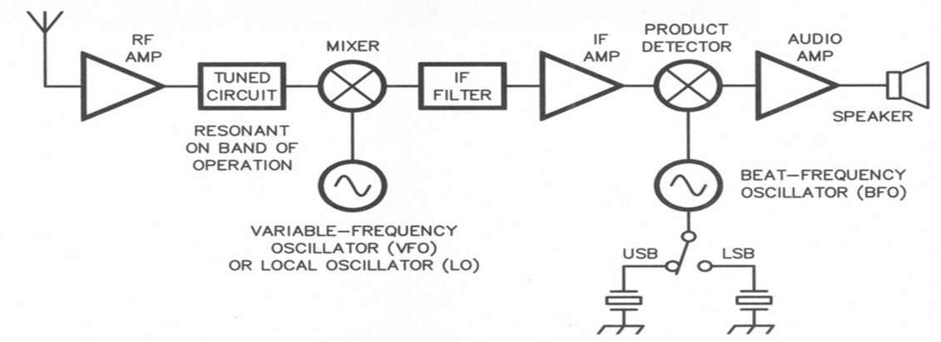
Superheterodyne Receiver – Walk-through
Received signals are incredibly weak – on the order of nano or picowatts
IF = Intermediate Frequency

Slide 147
Superhetrodyne Receiver
Received signals are first boosted by the RF amplifier, then applied to the RF input of a mixer
The local oscillator (LO) is adjusted so that the desired signal creates a mixing product at the intermediate frequency (IF)
A product detector (demodulator) stage follows the IF amplifier to extract (recover) the modulating information
Input amplifier gain, demodulator stage bandwidth, and input amplifier noise can all affect receiver sensitivity

Slide 148
Simplest Superhet
The simplest possible superheterodyne receiver consists of a mixer connected to the antenna, an HF oscillator to act as a LO, and a detector that operates directly on the resulting IF signal
Once amplified to a more usable level, SSB and CW signals are demodulated by a product detector - A type of mixer that combines the IF signal with the output of a beat frequency oscillator (BFO) to produce an audio frequency (AF) mixing product

Slide 149
Image Signals
Example: If the IF is 455 kHz and the LO frequency is 13.800 MHz, signals at both 14.255 and 13.345 MHz will create a mixing product at 455 kHz
Assuming the receiver is supposed to receive the 14.255 MHz signal, the undesired signal at 13.345 MHz is called an image
Filters in the RF Front End (the RF amplifier and first mixer) remove image signals to eliminate this interference

Slide 150
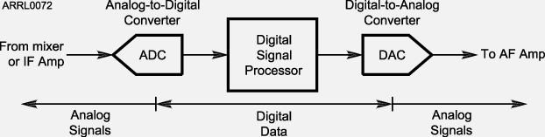
Digital Signal Processing
The general term for converting signals from analog to digital form, operating on them with a microprocessor, and converting them back to analog is digital signal processing (DSP)
A DSP IF Filter consists of an analog to digital converter,
a digital to analog converter, and a digital processor chip

Slide 151
Common DSP Functions
Signal filtering – offers a wide range of filters with adjustable bandwidth and shape, such as notch filters
Noise reduction – DSP can distinguish and remove some kinds of noise, leaving only the desired speech or CW for the operator to copy
Audio frequency equalization – Adjustable receive or transmit audio frequency response to suit preferences
DSP advantage: A wide range of filter bandwidths and shapes can be created

Slide 152
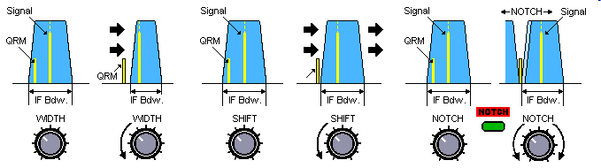
Common Manual or DSP Functions
Notch filtering – Interfering carrier signals in the receiver’s passband can be sensed and removed by DSP
An automatic notch filter can track interfering signals as they change frequency and eliminate more than one at a time

Slide 153
Notch Filter
C:\Users\ai2n\Videos\General Course - Videos\Notch_Filter_Demo.wmv

Slide 154
Common Manual or DSP Functions
One use for the IF shift control on a receiver is to avoid interference from stations very close to the receive frequency
Matching the receiver bandwidth to the bandwidth of the operating mode results in the best signal to noise ratio
Next two videos….

Slide 155
IF Shift - Width
C:\Users\ai2n\Videos\General Course - Videos\IF_Shift_Demo.wmv

Slide 156
Bandwidth Demo - RL3A
C:\Users\ai2n\Videos\General Course - Videos\RL3A Filter Demo.wmv

Slide 157
Common DSP Functions
A DSP noise blanker temporarily reduces receiver gain during noise pulses
As noise reduction level is increased received signals may become distorted – nothing is perfect; the noise blanker may interpret some signal components as noise

Slide 158
Use Opposite Sideband
An advantage of selecting the opposite or "reverse" sideband when receiving CW signals on a typical HF transceiver is that it may be possible to reduce or eliminate interference from other signals
C:\Users\ai2n\Videos\General Course - Videos\CW_Reverse_Demo.wmv
SO2R (Poland) calling CQ

Slide 159
Receiver Linearity
If the received signal is distorted, spurious signals will appear just as if a transmitting station were emitting them
A common form of receiver nonlinearity is caused by front-end overload
The attenuator and RF gain controls can reduce received noise and distortion caused by strong incoming signals

Slide 160
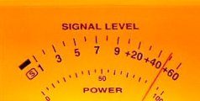
S Meter
S meters are found in receivers
The AGC circuit adjusts receiver gain by changing a voltage that controls the RF and IF amplifier gain
This voltage is read by the S meter of the receiver, which is used to measure received signal strength
(Note: S9, +20, etc)

Slide 161
S Meter
S meters are calibrated in S units, equal to about 6 dB change per S unit
S9 is at the midpoint of the S meter display – a very good signal
Additional markings +20, +40, and +60 correspond to dB above S9
A reading of S9 + 20 dB, therefore corresponds to a signal 20 dB (100 times) stronger than an S9 signal
To go from S8 to S9 on a distant receiver, transmitter output must rise by a factor of 4
3 dB = 2x change
6 dB = 4x change
10 dB = 10x change

Slide 162
Take Quiz 5

Slide 163
G4A01 - What is the purpose of the notch filter found on many HF transceivers?
A. To restrict the transmitter voice bandwidth
B. To reduce interference from carriers in the receiver passband
C. To eliminate receiver interference from impulse noise sources
D. To remove interfering splatter generated by signals on adjacent frequencies

Slide 164
G4A01 - What is the purpose of the notch filter found on many HF transceivers?
A. To restrict the transmitter voice bandwidth
B. To reduce interference from carriers in the receiver passband
C. To eliminate receiver interference from impulse noise sources
D. To remove interfering splatter generated by signals on adjacent frequencies

Slide 165
G4A02 - What is the benefit of using the opposite or "reverse" sideband when receiving CW?
A. Interference from impulse noise will be eliminated
B. More stations can be accommodated within a given signal passband
C. It may be possible to reduce or eliminate interference from other signals
D. Accidental out-of-band operation can be prevented

Slide 166
G4A02 - What is the benefit of using the opposite or "reverse" sideband when receiving CW?
A. Interference from impulse noise will be eliminated
B. More stations can be accommodated within a given signal passband
C. It may be possible to reduce or eliminate interference from other signals
D. Accidental out-of-band operation can be prevented

Slide 167
G4A03 - How does a noise blanker work?
A. By temporarily increasing received bandwidth
B. By redirecting noise pulses into a filter capacitor
C. By reducing receiver gain during a noise pulse
D. By clipping noise peaks

Slide 168
G4A03 - How does a noise blanker work?
A. By temporarily increasing received bandwidth
B. By redirecting noise pulses into a filter capacitor
C. By reducing receiver gain during a noise pulse
D. By clipping noise peaks

Slide 169
G4A07 - What happens as a receiver's noise reduction control level is increased?
A. Received signals may become distorted
B. Received frequency may become unstable
C. CW signals may become severely attenuated
D. Received frequency may shift several kHz

Slide 170
G4A07 - What happens as a receiver's noise reduction control level is increased?
A. Received signals may become distorted
B. Received frequency may become unstable
C. CW signals may become severely attenuated
D. Received frequency may shift several kHz

Slide 171
G4A13 - What is the purpose of using a receive attenuator?
A. To prevent receiver overload from strong incoming signals
B. To reduce the transmitter power when driving a linear amplifier
C. To reduce power consumption when operating from batteries
D. To reduce excessive audio level on strong signals

Slide 172
G4A13 - What is the purpose of using a receive attenuator?
A. To prevent receiver overload from strong incoming signals
B. To reduce the transmitter power when driving a linear amplifier
C. To reduce power consumption when operating from batteries
D. To reduce excessive audio level on strong signals

Slide 173
G4D04 - What does an S meter measure?
A. Carrier suppression
B. Impedance
C. Received signal strength
D. Transmitter power output

Slide 174
G4D04 - What does an S meter measure?
A. Carrier suppression
B. Impedance
C. Received signal strength
D. Transmitter power output

Slide 175
G4D05 - How does a signal that reads 20 dB over S9 compare to one that reads S9 on a receiver, assuming a properly calibrated S meter?
A. It is 10 times less powerful
B. It is 20 times less powerful
C. It is 20 times more powerful
D. It is 100 times more powerful

Slide 176
G4D05 - How does a signal that reads 20 dB over S9 compare to one that reads S9 on a receiver, assuming a properly calibrated S meter?
A. It is 10 times less powerful
B. It is 20 times less powerful
C. It is 20 times more powerful
D. It is 100 times more powerful

Slide 177
G4D06 - How much change in signal strength is typically represented by one S unit?
A. 6 dB
B. 12 dB
C. 15 dB
D. 18 dB

Slide 178
G4D06 - How much change in signal strength is typically represented by one S unit?
A. 6 dB
B. 12 dB
C. 15 dB
D. 18 dB

Slide 179
G4D07 - How much must the power output of a transmitter be raised to change the S meter reading on a distant receiver from S8 to S9?
A. Approximately 1.5 times
B. Approximately 2 times
C. Approximately 4 times
D. Approximately 8 times

Slide 180
G4D07 - How much must the power output of a transmitter be raised to change the S meter reading on a distant receiver from S8 to S9?
A. Approximately 1.5 times
B. Approximately 2 times
C. Approximately 4 times
D. Approximately 8 times

Slide 181
G7C04 - How is a product detector used?
A. Used in test gear to detect spurious mixing products
B. Used in transmitter to perform frequency multiplication
C. Used in an FM receiver to filter out unwanted sidebands
D. Used in a single sideband receiver to extract the modulated signal

Slide 182
G7C04 - How is a product detector used?
A. Used in test gear to detect spurious mixing products
B. Used in transmitter to perform frequency multiplication
C. Used in an FM receiver to filter out unwanted sidebands
D. Used in a single sideband receiver to extract the modulated signal

Slide 183
G7C06 - Which of the following is an advantage of a digital signal processing (DSP) filter compared to an analog filter?
A. A wide range of filter bandwidths and shapes can be created
B. Fewer digital components are required
C. Mixing products are greatly reduced
D. The DSP filter is much more effective at VHF frequencies

Slide 184
G7C06 - Which of the following is an advantage of a digital signal processing (DSP) filter compared to an analog filter?
A. A wide range of filter bandwidths and shapes can be created
B. Fewer digital components are required
C. Mixing products are greatly reduced
D. The DSP filter is much more effective at VHF frequencies

Slide 185
G7C08 - Which parameter affects receiver sensitivity?
A. Input amplifier gain
B. Demodulator stage bandwidth
C. Input amplifier noise figure
D. All these choices are correct

Slide 186
G7C08 - Which parameter affects receiver sensitivity?
A. Input amplifier gain
B. Demodulator stage bandwidth
C. Input amplifier noise figure
D. All these choices are correct

Slide 187
G8B01 - Which mixer input is varied or tuned to convert signals of different frequencies to an intermediate frequency (IF)?
A. Image frequency
B. Local oscillator
C. RF input
D. Beat frequency oscillator

Slide 188
G8B01 - Which mixer input is varied or tuned to convert signals of different frequencies to an intermediate frequency (IF)?
A. Image frequency
B. Local oscillator
C. RF input
D. Beat frequency oscillator

Slide 189
G8B02 - What is the term for interference from a signal at twice the IF frequency from the desired signal?
A. Quadrature response
B. Image response
C. Mixer interference
D. Intermediate interference

Slide 190
G8B02 - What is the term for interference from a signal at twice the IF frequency from the desired signal?
A. Quadrature response
B. Image response
C. Mixer interference
D. Intermediate interference

Slide 191
G8B09 - Why is it good to match receiver bandwidth to the bandwidth of the operating mode?
A. It is required by FCC rules
B. It minimizes power consumption in the receiver
C. It improves impedance matching of the antenna
D. It results in the best signal-to-noise ratio

Slide 192
G8B09 - Why is it good to match receiver bandwidth to the bandwidth of the operating mode?
A. It is required by FCC rules
B. It minimizes power consumption in the receiver
C. It improves impedance matching of the antenna
D. It results in the best signal-to-noise ratio

Slide 193
Next Week
Chapters 5.5, 6

